Slide 1
ECG SIGNAL ANALYSIS: DETERMINE HEART RATE AND DETECT ABNORMALITIES
AIM:
The electrocardiogram (ECG) signal shows the electrical activity of the heart in terms of quasi periodic voltage signals. The signal can be studied and processed to analyze the activity of the heart. We aim to measure the heart rate and flag any heart abnormality or arrhythmia by ECG signal analysis.

Slide 2
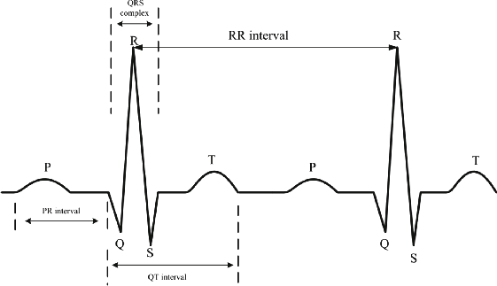
COMPONENTS OF ECG SIGNAL :
Electrocardiogram is the record of electrical activity of heart. ECG is a test to detect and study normal rhythmic activity of the heart.
The typical ECG signal consists of P, QRS, T, U components.
The QRS complex plays a vital role in identifying the problems that occur with the functioning of heart. If any problems are associated with the heart, then the QRS complex lengthens or widens or becomes shorter.
The R-R interval is used to determine heart beat rate.
The abnormalities in the rhythm are mainly observed with the help of parameters QRS duration, R-R interval and heart beat rate.

Slide 3
STRATEGY:
Step 1
Data collection and modification of data.
Step 2
Step 3
Finding Q,R,S peaks in the plot using MATLAB
Filtering the data using low and high pass filters.
Step 4
Determining heart rate with the help of peaks.
Step 5
Classification of heartbeat sample into normal, abnormal, tachycardia, bradycardia based on heartbeat and QRS average value.

Slide 4
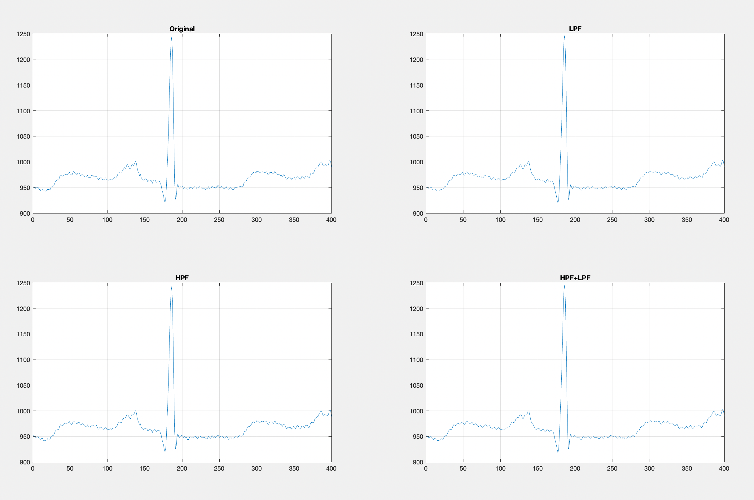
Filtering NOise with lp and hp Filter:
In the real world, interferences from surgical equipments and AC-power supply can add noise to the ECG signal.
We used designfilt() to create a low pass and high pass filter to remove the baseline wander noise from the signal.
In order to minimize noise fluctuations, we processed data by avg, max and random pool functions.

Slide 5
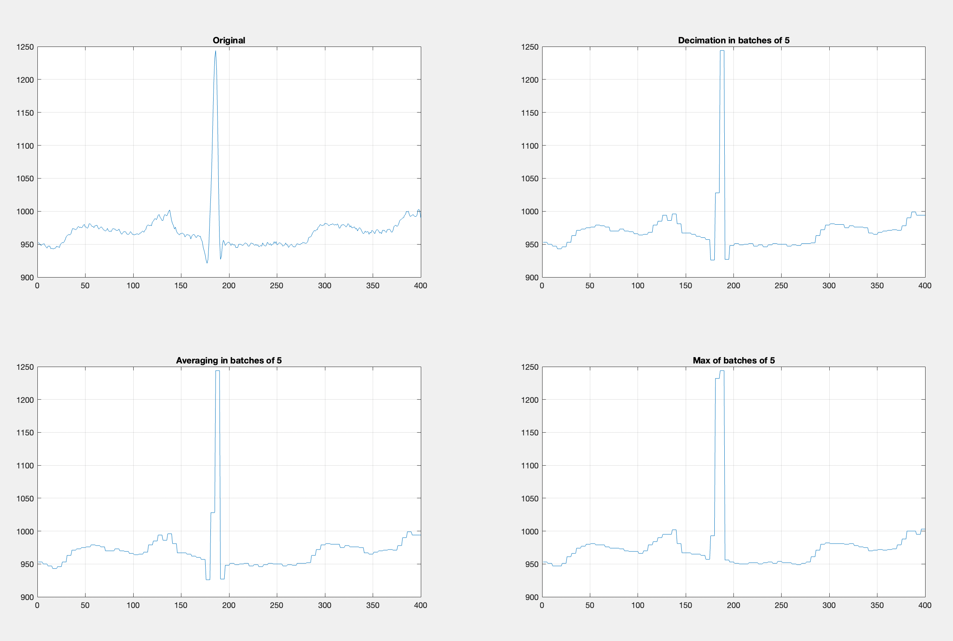
DATA Processing:
To further smoothen the fine fluctuations, we processed and analysed the signals by applying the pooling technique (max-pool filter, average-pool filter)
Max-pool and Average-pool filter: Maximum and average value of 5 adjacent samples was calculated and assigned to those 5 samples.

Slide 6
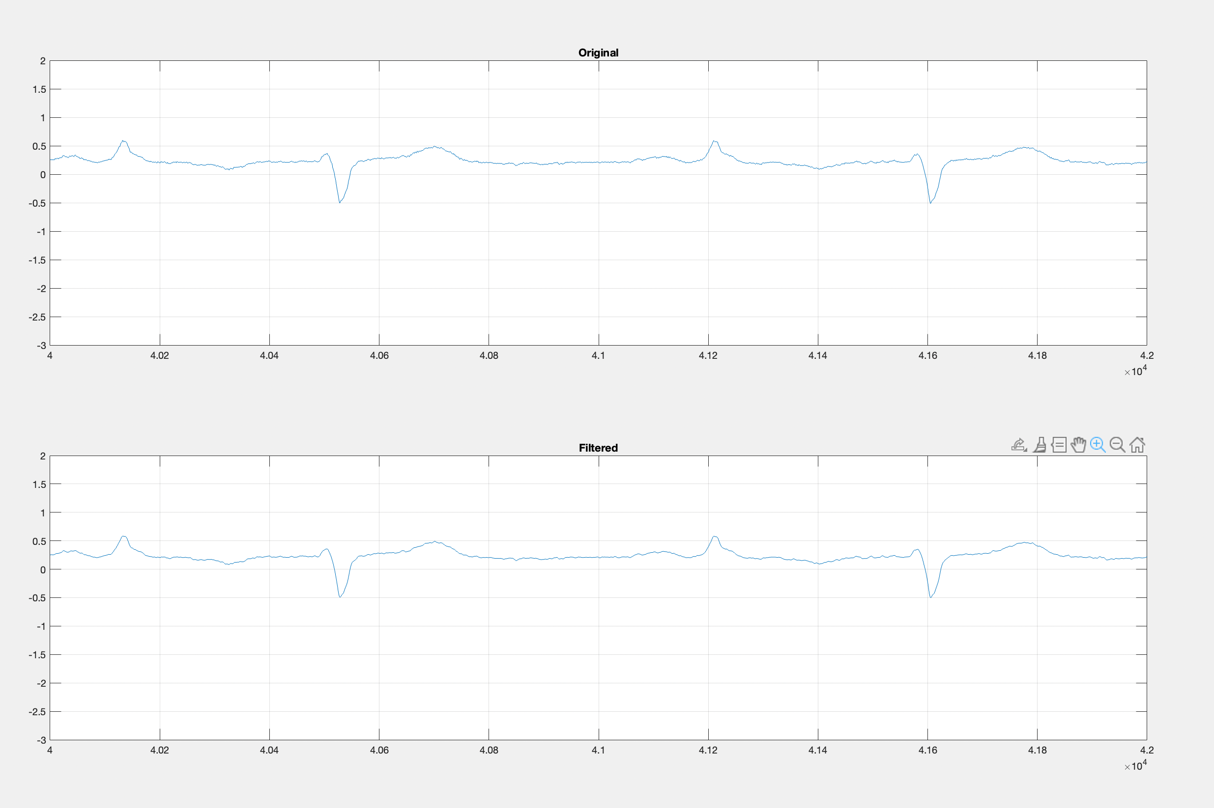
Filtering: For noise reduction, Savitzky-Golay filtering on the original datA is aPPlied
In the above plot, the library function "sgolayfilt()" is used to filter the data.

Slide 7
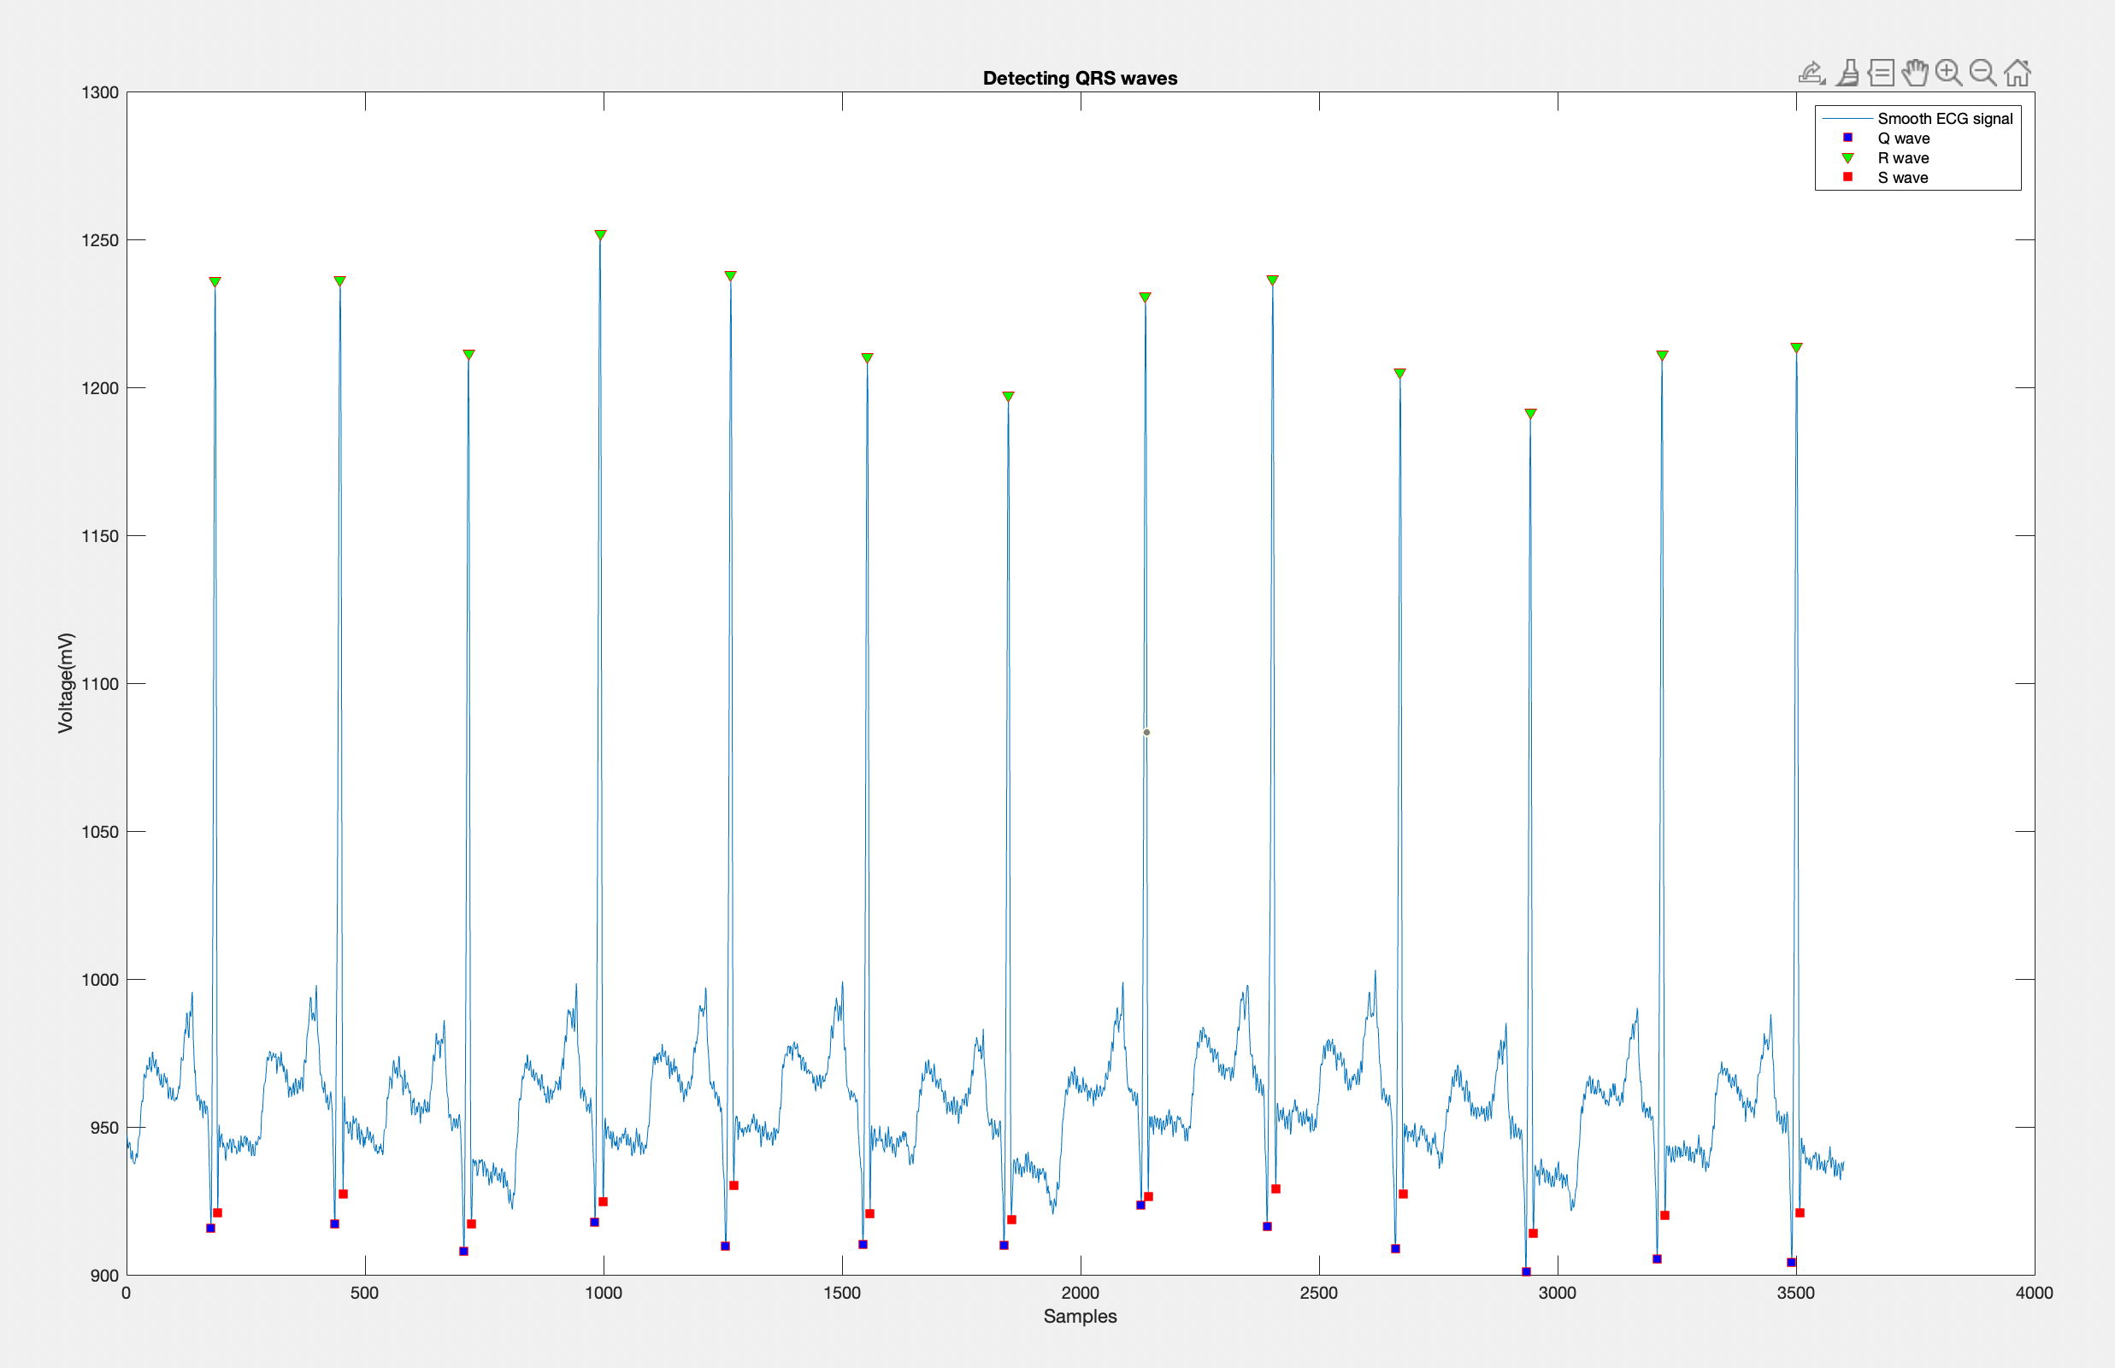
Peak Identification:
R Peaks: Using threshold value method, Location and number of R peaks identified. Minimum value of and minimum distance between peaks also set.
Q and S peaks: Using R-peak location data, adjacent Q and S peaks were Identified. Minimum value of and minimum distance between peaks also set.
Average R-R interval length: calculated from R peak location values
Average QRS complex length: calculated from Q and S peak location values

Slide 8
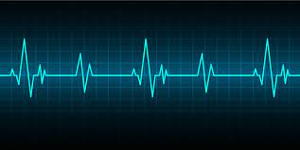
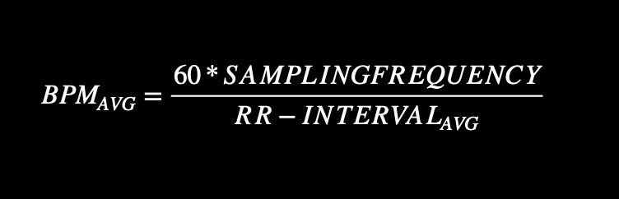
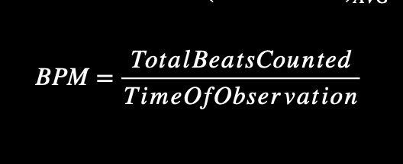
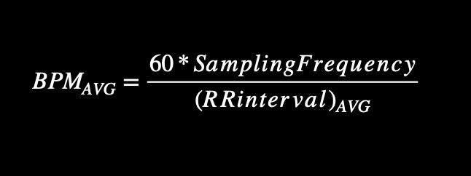
Determining Heart Rate:
We calculated heart rate using this, but got inaccurate results as our samples were 10 seconds long only:
The heart rate was computed by finding out the average R-R peak distance, and then the following scheme was applied :

Slide 9
Determining Abnormalities:
BRADYCHARDIA
Bradycardia is a slower than normal heart rate. If you have bradycardia, your heart beats fewer than 60 times a minute.
Bradycardia can be a serious problem if the heart rate is very slow and the heart can't pump enough oxygen-rich blood to the body.
TACHYYCHARDIA
Tachycardia is the medical term for a heart rate over 100 beats a minute. Many types of irregular heart rhythms (arrhythmias) can cause tachycardia.
Tachycardia may not cause any symptoms or complications. But, some forms of tachycardia can lead to serious health problems, including heart failure, stroke or sudden cardiac death
QRS COMPLEX LENGTH
A healthy heart has QRS complex length between 0.06 to 0.1 seconds
The QRS duration will lengthen when electrical activity takes a long time to travel throughout the ventricular myocardium.

Slide 10
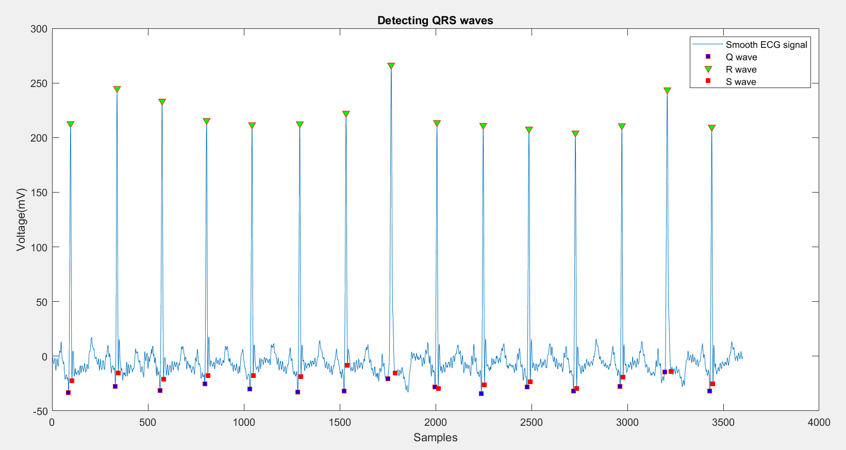
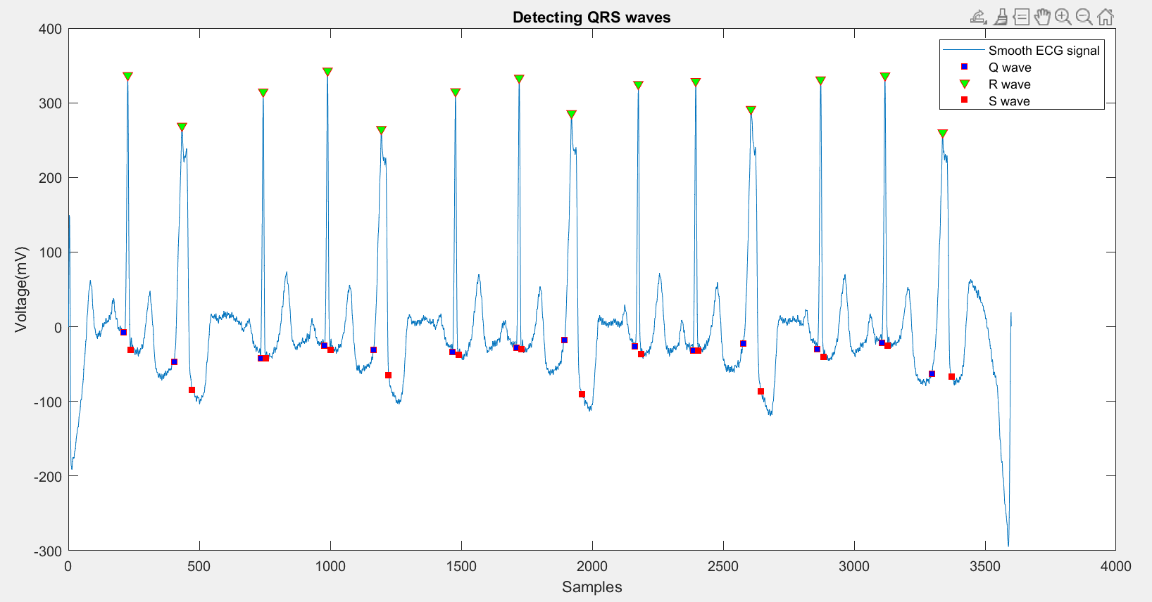
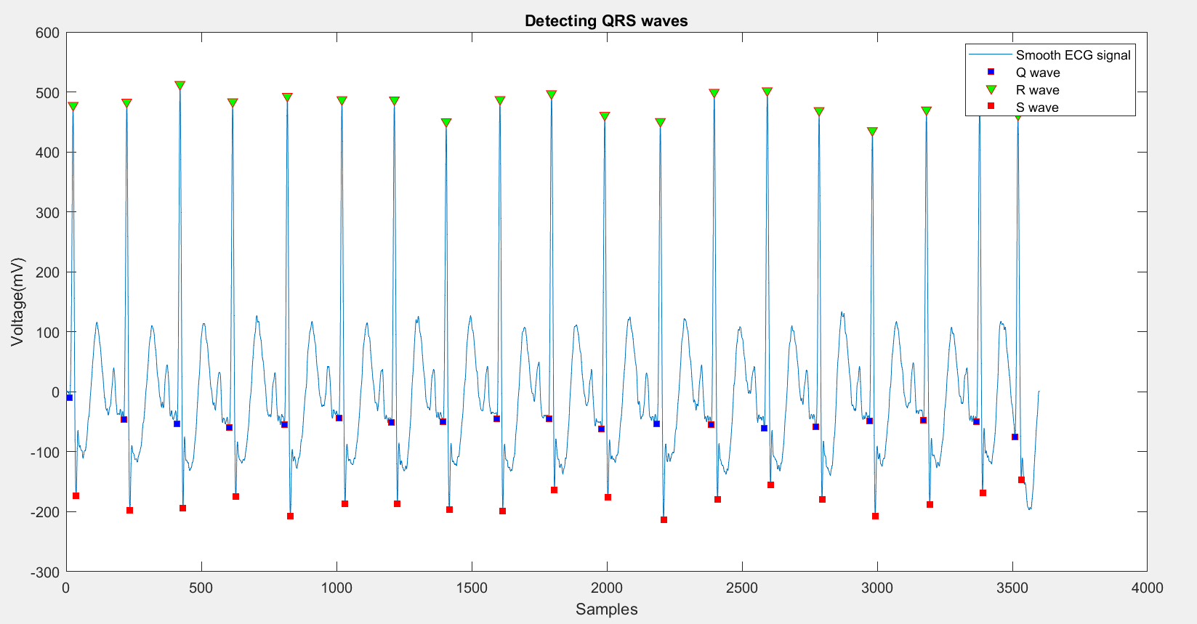
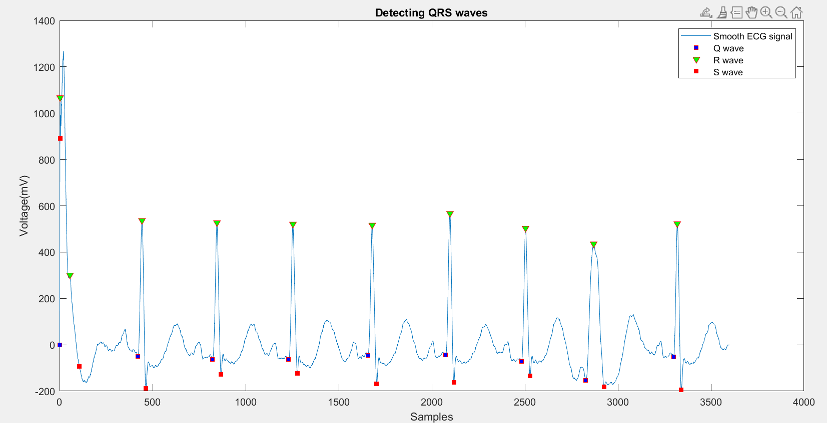
RESULTS:
S.no | File Name | Signal Plot | Result
1. | t1.mat |  | Normal Heartbeat
2. | t2.mat |  | Abnormal Heartbeat
3. | t3.mat |  | Tachycardia
4. | t4.mat |  | Bradycardia

Slide 11
CONCLUSION
The Heart Beat rate computation and abnormality detection are successfully done considering all the factors. All the necessary parameters QRS peaks, average RR intervals, Beats Per Minute(BPM) and average QRS intervals are computed and are used for the detection of any abnormalities in the heart. Most of the cardiac problems in existence can thus be identified due to the irregularities in the ECG of the person by calculating the heart rate and also considering the aforementioned parameters.

Slide 12
ACKNOWLEDGEMENTs and scope of further work
We would like to express our special thanks of gratitude to Prof. Abhishek Dixit who wonderfully taught us about and Signals and Systems and gave us this golden opportunity to work on real life application of signal analysis and processing. It was only possible because of the guidance of our TA Bhavya Kalani who helped clearing our doubts at every stage of the project.
The signal data used in this project was obtained from "physionet.org" and the library functions were obtained from the official MATLAB documentation.
Using concepts of ML/AI we can further increase the accuracy of out model and detect many more abnormalities and diseases related to ECG signal.
We can also switch to more complicated algorithms for peak identification for increasing the accuracy and hence making the results more reliable.
We can also modify our algorithm slightly to monitor real time data for abnormality detection.

Slide 13

THANK YOU!
Sharma Kartik
Singh Gurarmaan
Sonone Shreya

